Slide 1


1
PRESIDENCY UNIVERSITY
School of Artificial Computing
Intelligence
and Advanced

Slide 2

CSS7102-Mini Project Review-03
CIVIC-VOICE An AI .Assistant for Multi-Channel Citizen Feedback Analysis
in Public Services
Batch Number: CAI-20
Under the Supervision of,
Dr. Jagadevi Bakka Assistant Professor School of Computer Science and Engineering Presidency University
Roll Number
20231CAI0117 20231CAI0120 20231CAI0115
Student Name
Inchara KR
Peddi Reddy Tejaswini
Sahana Haragapure
Name of the Program: B.Tech
Name of the HoD:Dr. ZafarAli Khan N
Name of the Program Project Coordinator:Dr.JagadeviBakka
Name of the School Project Coordinators: Dr. Sampath A K

Slide 3
Content
  Problem Statement
  Abstract
  Github Link
  Objective
  Analysis of Problem Statement
  Dataset and Data Source
  NLP Analysis
  Project Achitecture
  Timeline of the Project
  Results and Insights
  References

Slide 4
Problem Statement Number: 40
Organization: Public Service Organizations (Government Agencies)
Category : Software
Problem Description:
Citizen feedback is received through multiple channels such as government grievance portals, local complaint systems, social media, emails and surveys. These sources are heterogeneous and are often analyzedseparately,makingitdifficulttoidentifycommonissuesandemergingconcerns.
Civic Voice aims to unify multi-channel citizen feedback and apply NLP-based analysis to identify sentiment, recurring topics, important complaints and emerging issues through an interactive dashboard.
Difficulty Level: Medium–High

Slide 5
Abstract:
CIVIC-VOICE is an AI-based system designed to analyze citizen feedback collected from multiple channels including government grievance portals, local complaints, surveys, social media and emails.
During the current implementation phase, heterogeneous datasets were collected, normalized and integrated into a unified master dataset. A text preprocessing pipeline was developed to clean and standardize citizen feedback and prepare it for downstream NLP analysis.
The current master dataset contains 205,168 feedback records from five sources. Data validation and exploratory analysis were performed to examine text quality, missing information, urgency distribution and other data-quality issues.
The processed dataset will be used for subsequent sentiment analysis, topic detection, issue classification, prioritization and dashboard development.

Slide 6
Github Link
Github Link:
https://github.com/CivicVoice-AI/AI-Assistant-for-Multi-Channel-Citizen-
Feedback-Analysis

Slide 7
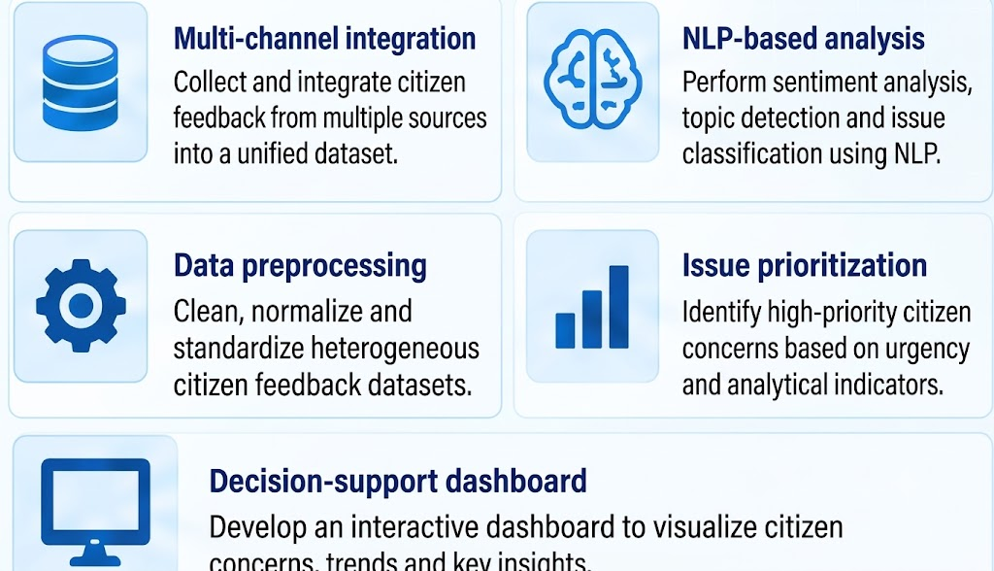
Objectives

Slide 8
Analysis of Problem Statement
Technology Stack Components:
Component
Technology
Purpose
Frontend
Streamlit / HTML, CSS, JavaScript
User interface and dashboard
Backend
Python, Flask (or FastAPI)
API development and application logic
Programming Language
Python
Core development
NLP & AI
Hugging Face Transformers, BERT, NLTK,spaCy
Textpreprocessing, sentiment analysis,summarization
Complaint classification and model evaluation
Machine Learning
Scikit-learn

Slide 9
Analysis of Problem Statement (contd...)
Component
Technology
Purpose
Database
Data Processing
MySQL Pandas, NumPy
Store citizen feedback and analysis results Data cleaning and manipulation
Visualization
Plotly, Matplotlib
Graphs, charts, and analytics
Development Environment
Jupyter Notebook, VS Code
Model development and coding
Version Control
Git & GitHub
Source code management and collaboration
Deployment
Render / Railway / Streamlit Cloud
Deploy the web application

Slide 10
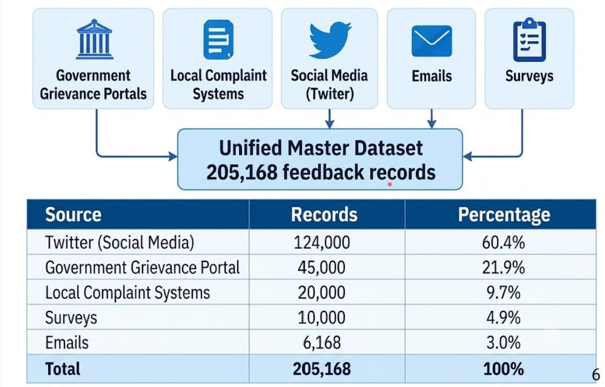
Dataset and Data Source

Slide 11
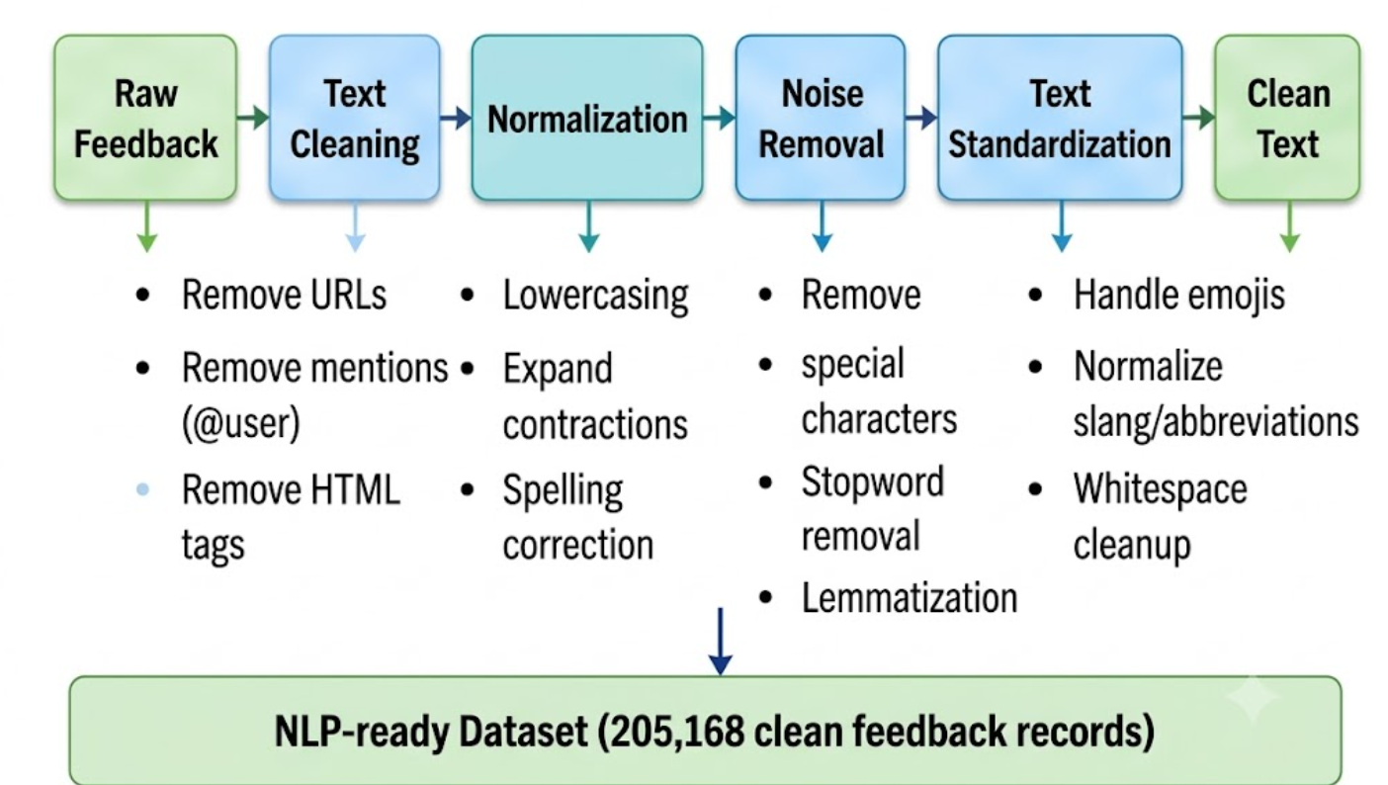
NLP Preprocessing

Slide 12
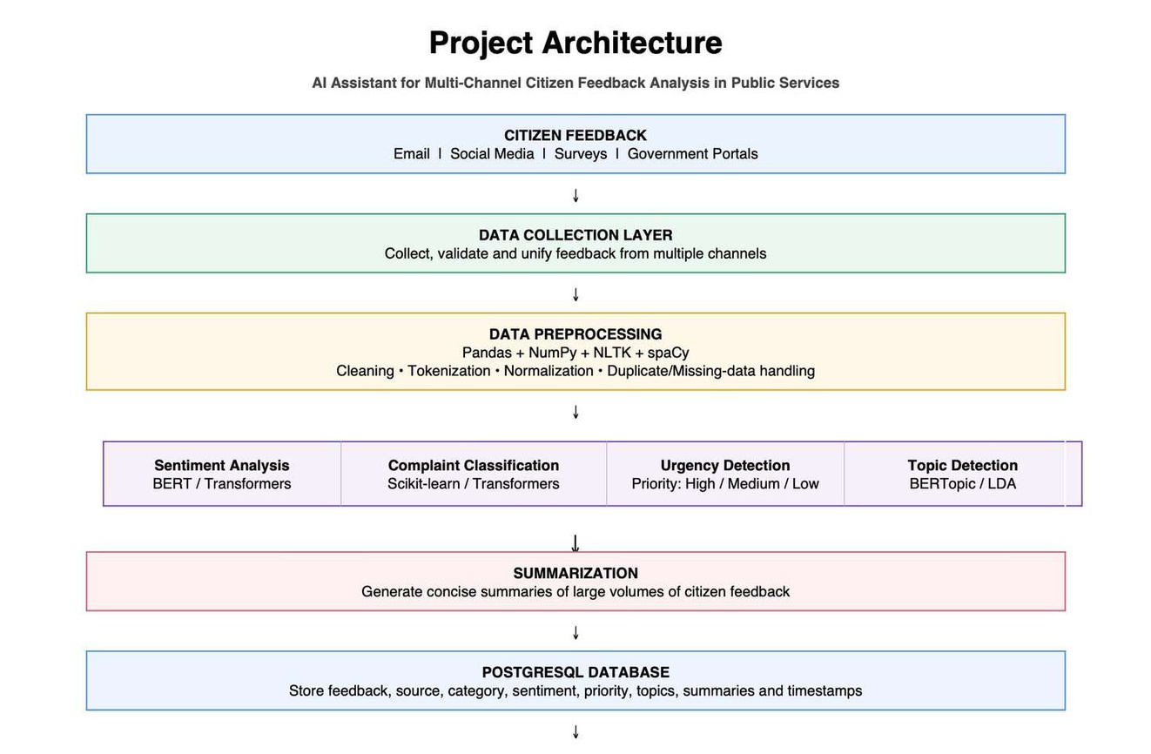
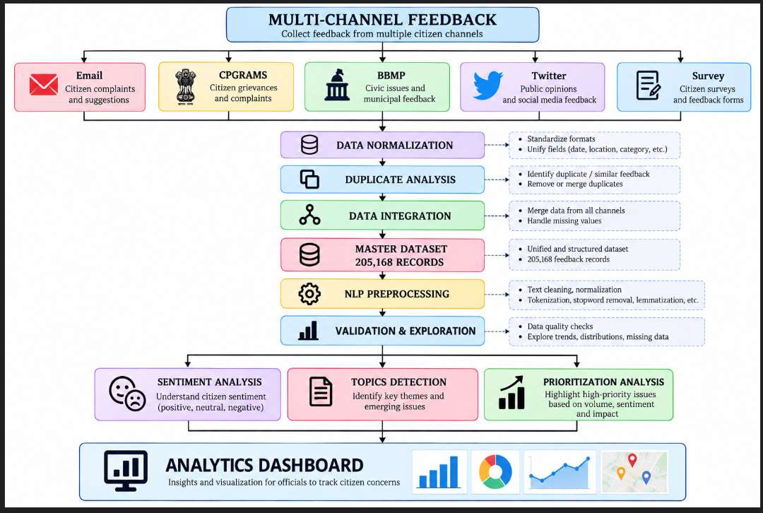

Slide 13
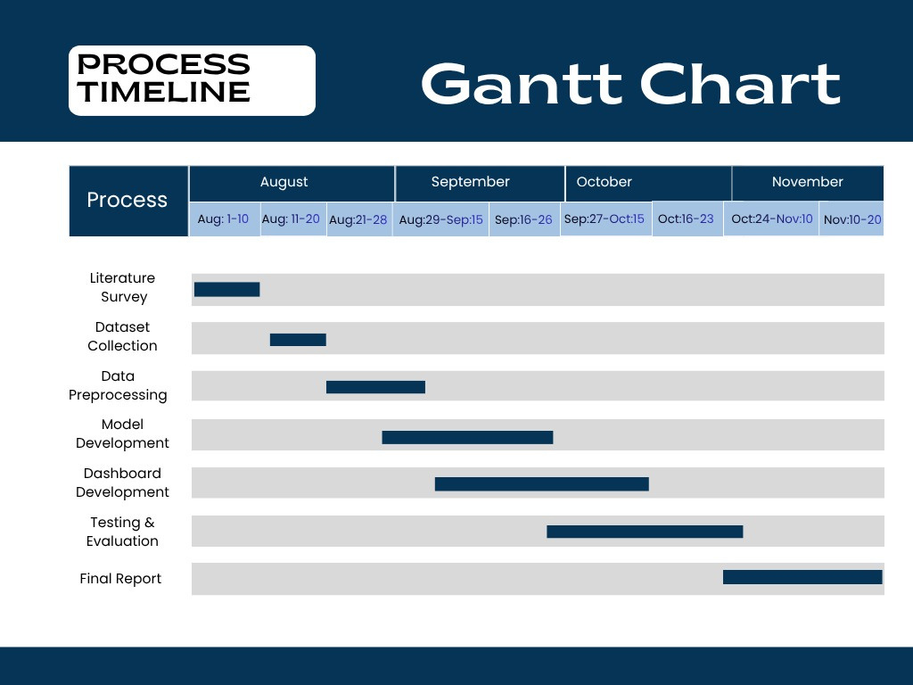
Timeline of the Project (Gantt Chart)

Slide 14
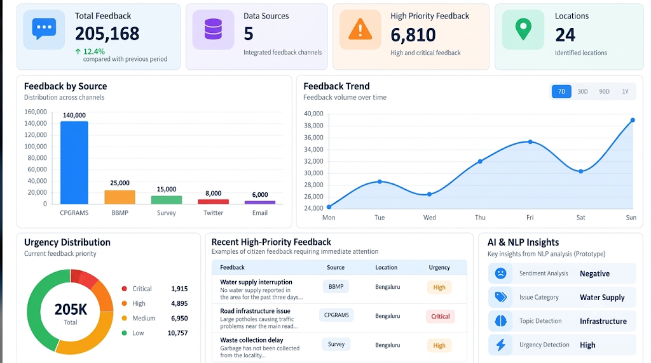
Results and Insights

Slide 15
References (IEEE Paper format)
•
Sarvestani,M.(2025).An NLP-basedframework for sentiment and topic analysis of citizen feedback on
U.K. government mobile applications. IEEE Access, 13, 210360–210377.
https://doi.org/10.1109/ACCESS.2025.3641669
• Airlangga, M. C., et al.
(2023). Understanding citizen feedback of Jakarta government super app:
(pp. 1–6).
Leveraging deep learning models. In 2023 IEEE International Smart Cities Conference (ISC2)
IEEE.
https://doi.org/10.1109/ISC257844.2023.10293572
•Alkraiji, A. I. (2020). Citizen satisfaction with mandatory e-government services: A conceptual
framework and an empirical validation. IEEE Access, 8, 117253–117265. https://doi.org/10.1109/ACCESS.2020.3004541
•S. K., A. Ravikurnar, V. R C., A. Reddy D., A. K. M. and S. K.P., "Sentiment Analysis of Indian
LanguagesusingConvolutionalNeuralNetworks,"2018InternationalConferenceonComputer
Communication and Informatics (ICCCI), Coimbatore, India, 2018, pp. 1-4, https://doi.org/ 10.1109/ICCCI.2018.8441371.

Slide 16
•G. Chauhan, S. Puri and R. Nahta, "Analysis of Government Flagship Programs using Public Feedbacks,"
20232ndInternationalConferenceforInnovationinTechnology(INOCON),Bangalore,India,2023,pp.1-7, https://doi.org/10.1109/INOCON57975.2023.10101351
•I. H. Hafidz, A. Sulistya and B. R. Lidiawaty, "Sentiment Analysis of Public Complaints: A Machine Learning
Comparison of SVM, Naive Bayes, Random Forest, and XGBoost," 2025 International Conference on Advancement in Data Science, E-learning and Information System (ICADEIS), Bandung, Indonesia, 2025, pp. 1-6,
https://doi.org/10.1109/ICADEIS65852.2025.10933382
•C. Nagesh, B. Divyasree, K. Madhu, T. Allisha, S. Datta Koushlk and P. Naresh, "Enhancing E-Government
through SentimentAnalysis:ADualApproachUsingTextandFacialExpressionRecognition,"2024
International Conference on Science Technology Engineering and Management (ICSTEM), Coimbatore, India, 2024,pp. 1-6,
https://doi.org/10.1109/ICSTEM61137.2024.10560678
•
G.A.Sandag,E. H.E.Soegiarto,L. Laoh,A.Gunawan andD.Sondakh,"SentimentAnalysisofGovernment
Policy Regarding PPKM on Twitter Using LSTM," 2022 4th International Conference on Cybernetics and IntelligentSystem (ICORIS),Prapat, Indonesia,2022, pp.1-6,
https://doi.org/ 10.1109/ICORIS56080.2022.10031474.

Slide 17


